Slide 1


Bioinformatics resources to study PPIs
Allegra Via
This presentation is adapted from the materials kindly provided by Luana Licata, MINT, University of Rome Tor Vergata

Slide 2
Protein-Protein Interactions (PPIs)
PPIs are physical contacts due to biochemical events and/or electrostatic forces between two or more proteins.
PPIs can occur only in a specific biological context and between specific molecular regions
Proteins rarely act alone
Most molecular processes within a cell are carried out by molecular machines made up of a large number of interacting proteins (complexes)

Slide 3
Protein-Protein Interactions (PPIs)
INTERACTOME: A protein-protein interaction network
An interactome provides information about the organization of a cell
Interactome models can be used to predict poorly characterised proteins into their functional context
If the function of one protein is known, the function of its binding partners is likely to be related ("guilty by association")

Slide 4
Methods to detect protein-protein interactions
A variety of techniques and methods have been developed to generate PPI data.
High throughput techniques
Low throughput techniques
These techniques can be further divided in:
Binary methods: techniques detecting direct physical associations between two proteins, called
Co-complex methods: techniques detecting interactions among groups of proteins that may not be in physical contact

Slide 5
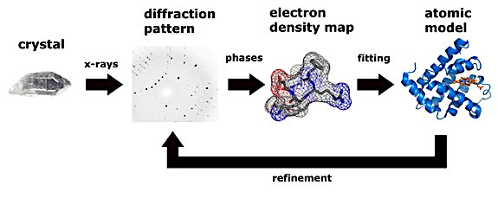
Methods to detect protein-protein interactions
Some low throughput techniques, such as FRET, SPR, ITC, NMR and X-ray crystallography, provide deeper insight certain characteristic of an interaction.
X-ray crystallography is considered the gold standard for PPI, since it provides high quality data for binding surfaces to the level of individual atoms and binding sites.
From Thomas Splettstoesser (www.scistyle.com)

Slide 6
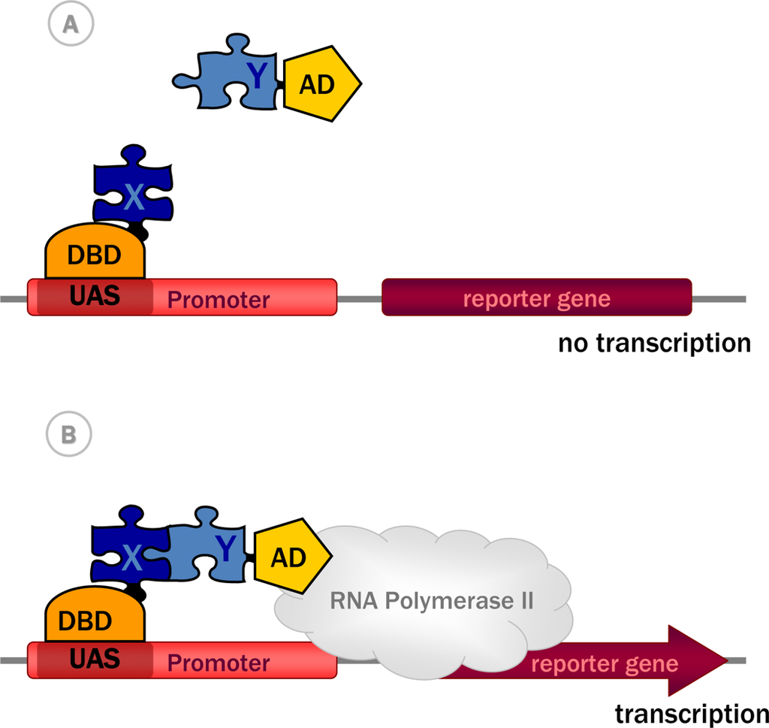
Methods to detect protein-protein interactions
The main binary methods for measuring of direct physical interactions between protein pairs is Yeast two-hybrid (Y2H) - The strategy interrogates two proteins, called bait and prey, coupled to two halves of a transcription factor and expressed in yeast. If the proteins make a contact, they reconstitute the transcription factor that activates a reporter gene.
From Yeast Two-Hybrid, a Powerful Tool for Systems Biology, Anna Brückner , Cécile Polge, Nicolas Lentze, Daniel Auerbach and Uwe Schlattner, Int. J. Mol. Sci. 2009

Slide 7
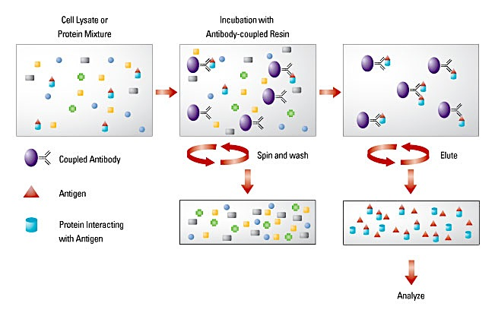
Methods to detect protein-protein interactions
The most common co-complex method is co-immunoprecipitation (co-IP) coupled with mass spectrometry (MS). In this approach, the bait protein, usually expressed in the cell in vivo conditions, is affinity purified and the interacting partners are detected by mass spectrometry.

Slide 8
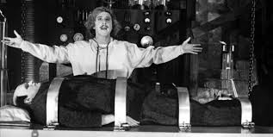





Databases and curation
Wet Lab Scientists
Scientific Curators
Molecular Interaction
DataBases

Slide 9
Molecular Interaction Databases
Molecular interaction databases have been established to collect, archive and disseminate molecular interaction data in a structured format to perform searches and bioinformatics analyses

Slide 10
Molecular Interaction Databases
Molecular interaction databases can be divided in:
Primary databases: experimentally proven protein interactions coming from either small- or large-scale published studies that have been manually curated
Meta databases: experimentally proven PPIs obtained by consistent integration of several primary databases
Prediction databases: mainly predicted PPIs derived using different approaches, combined with experimentally proven PPIs.

Slide 11
PPI databases categorisation and qualification
Type of data captured:
Only PPI information as in MINT and DIP.
Interactions between proteins and other molecules (DNA, RNA, small molecules) as in IntAct and MatrixDB.
PPIs and genetic interactions as in BIOGRID.
Only PPIs related to a specific scientific topic such as : InnateDB (PPIs in the immune system), MPIDB (PPIs in microbes) and MatrixDB (extracellular PPIs).
Type of curation Policy:
Databases describing PPIs with low level of curation detail and quality control procedures
Databases describing PPIs with high level of curation details and high accuracy of quality control procedures such as IMEx-complying databases.

Slide 12
Principal Molecular Interaction Databases
A more complete list of molecular
interaction databases is
available at:
http://www.pathguide.org
Luana Licata and Sandra Orchard, The MIntAct Project and Molecular Interaction Databases,
Methods in Molecular Biology Chapter, Springer, in press.

Slide 13
The IMEx Consortium
An international collaboration between a group of major public interaction data providers who have agreed to share curation effort (www.imexconsortium.org)
12 active molecular interaction databases dedicated to producing high quality, annotated data, curated to the same standards and following the same curation rules
Data is curated once at a single centre then exchanged between partners
Users need only go to a single site to obtain all data
Imex Central
The web service IMEx Central (https://imexcentral.org/icentralbeta/) is a central resource to assign IMEx IDs to the publications curated by IMEx members (version BETA-0.93 has been recently released).
Curators can check by using the NCBI PubMed identifier (PMID) if other IMEx members have curated an already published paper and therefore it allows avoiding work duplication.

Slide 14
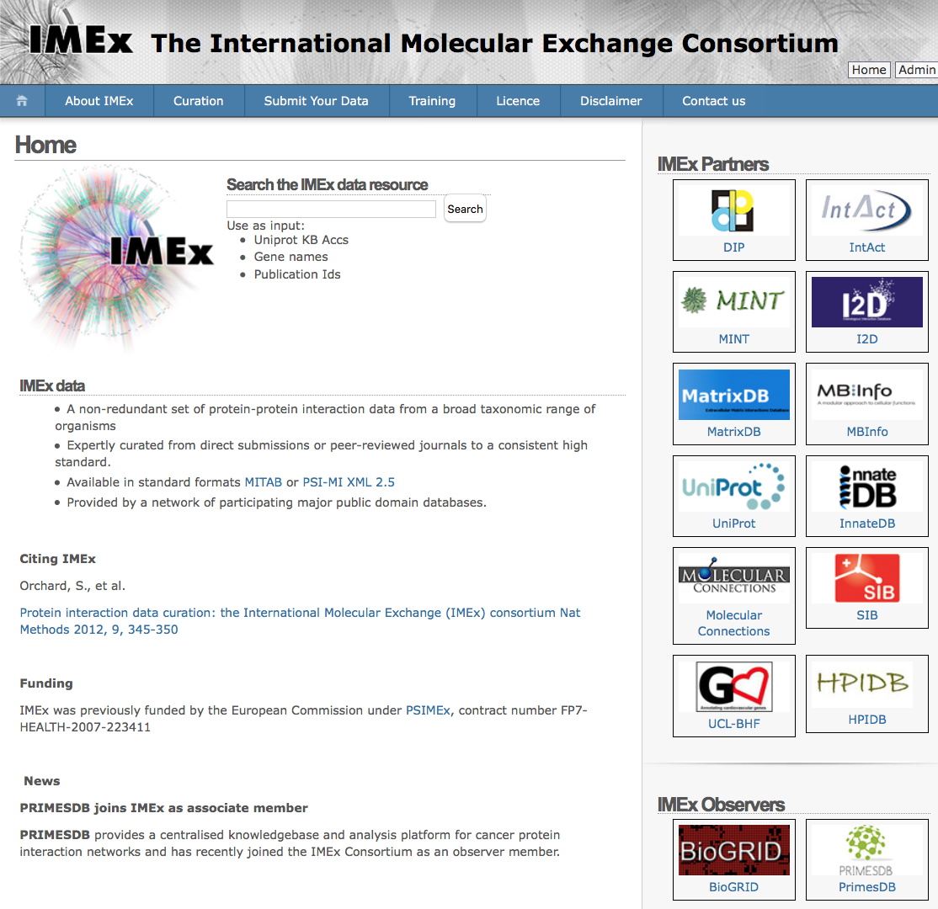
IMEx Consortium

Slide 15
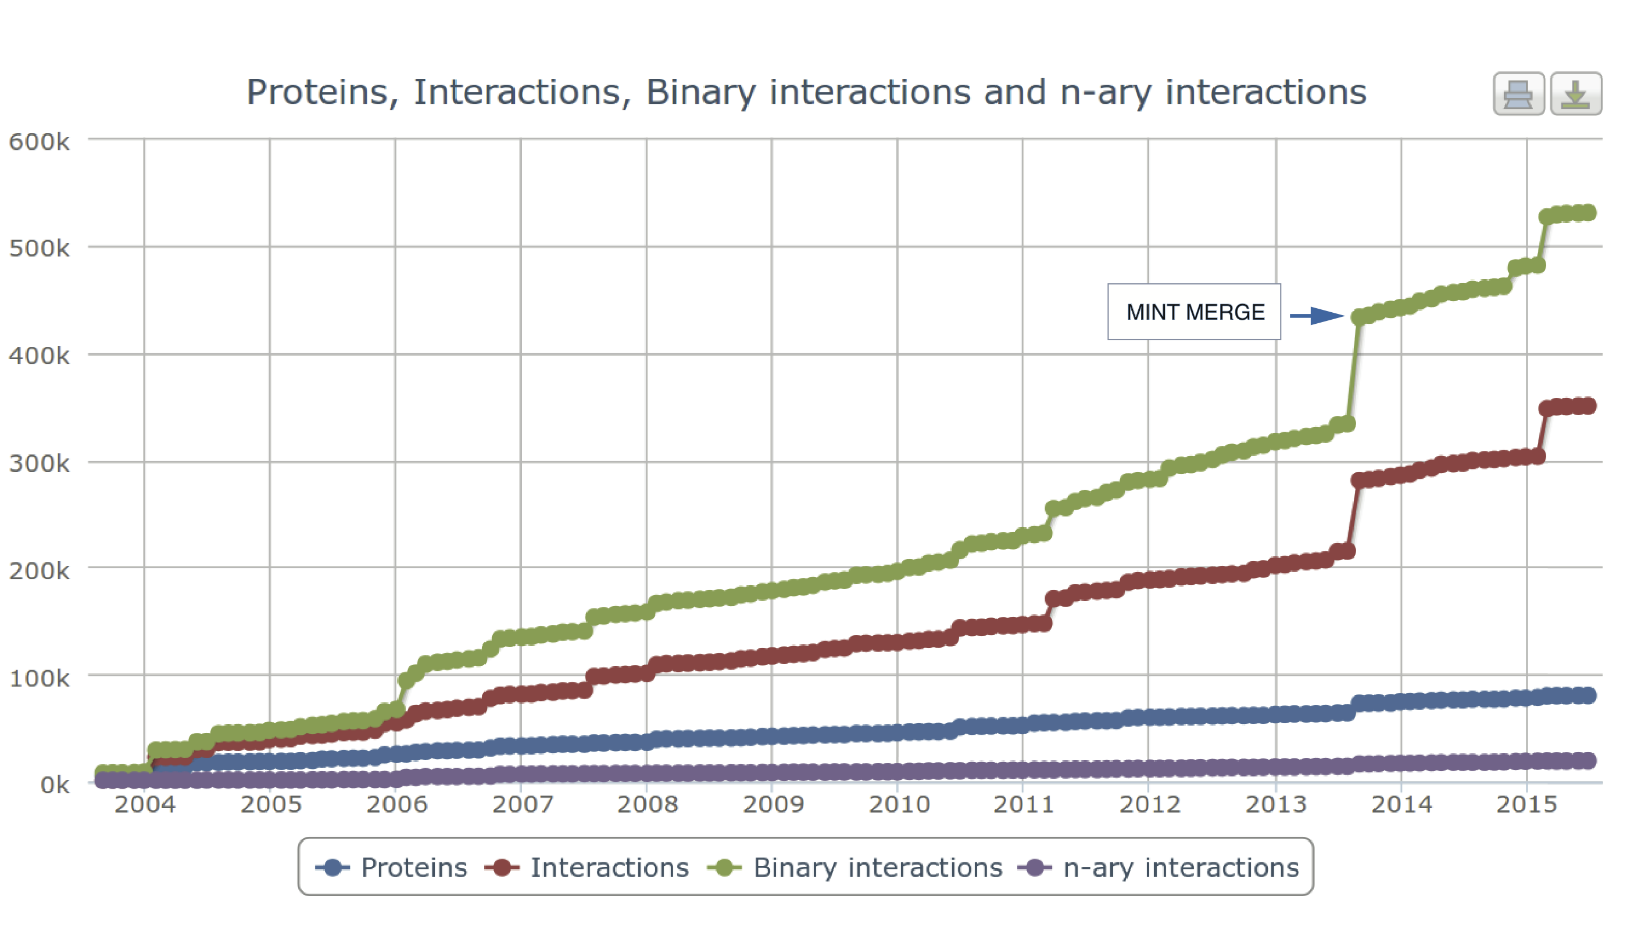
MintAct Project
MINT and IntAct databases were two of the largest databases (number of manuscripts curated + number of non-redundant interactions).
Both adopted the highest possible data quality standards.
Both were founder members of the IMEx Consortium.
IntAct and MINT joined their forces to create a single resource to improve curation and software development efforts.
Data maintenance, and the PSICQUIC and IMEx web services are the responsibility of the IntAct team, while the curation effort is undertaken by both IntAct and MINT curators.

Slide 16
MintAct goals & achievements
Freely available open-source database of molecular interactions (mainly PPIs). ~560K binary interactions taken from >13892 publications (November 2015)
Data is standard-compliant and available via the IntAct website, for download at the ftp site or via PSICQUIC:
http://www.ebi.ac.uk/intact
ftp://ftp.ebi.ac.uk/pub/databases/intact
www.ebi.ac.uk/Tools/webservices/psicquic/view/main.xhtml

Slide 17
A close look into a molecular interaction database
How to search a molecular interaction database?
Which information is it possible to retrieve?
Which kind of data are collected in an interaction database?
How is it possible to download data?
How can data be visualised?

Slide 18
Representing PPIs: Interacting Domains
The way to represent binding domain
of interacting proteins in IMEx databases
Prot A
Prot B
Prot C
Prot A
Prot B
Prot C

Slide 19
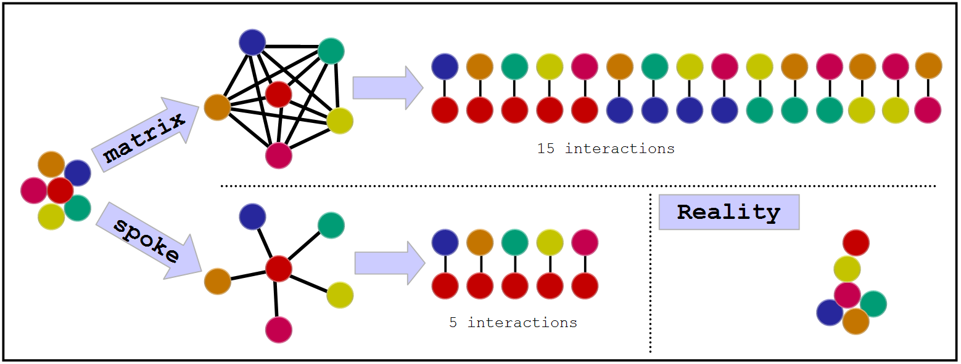
Complex representation
Several experimental techniques produce complex data: Eg. co-IP coupled with MS
There are two algorithms available to convert complexes into binary interactions
http://www.ebi.ac.uk

Slide 20
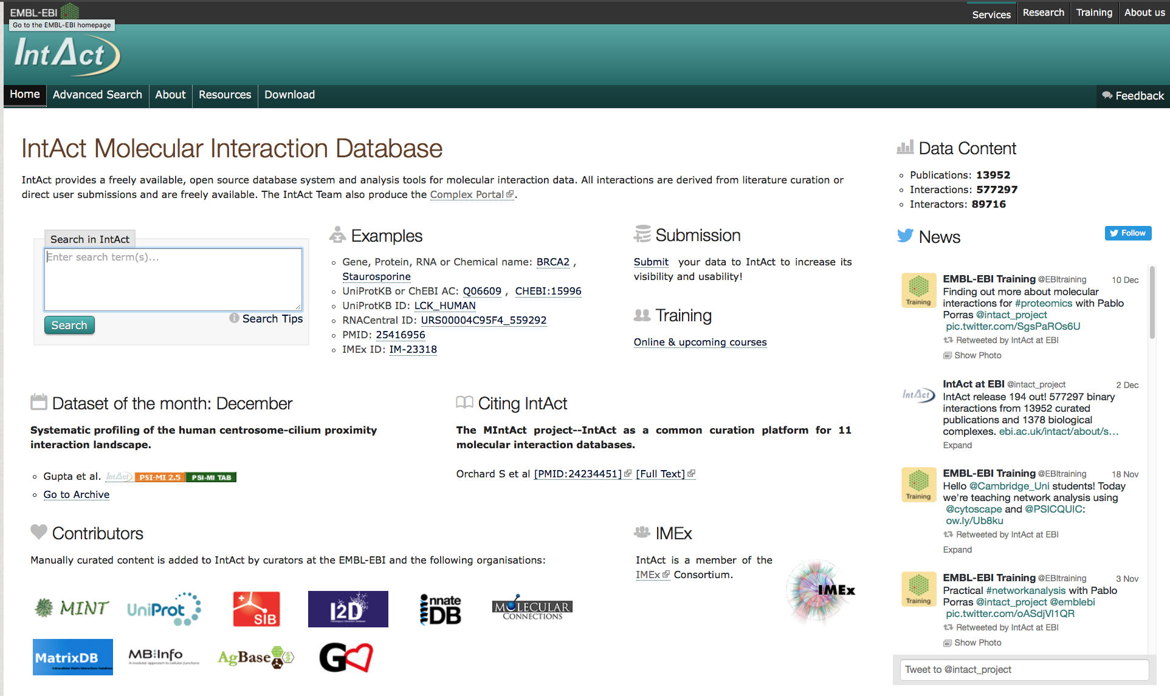
The IntAct database
IntAct Home Page (http://www.ebi.ac.uk/intact/)
Creb1

Slide 21
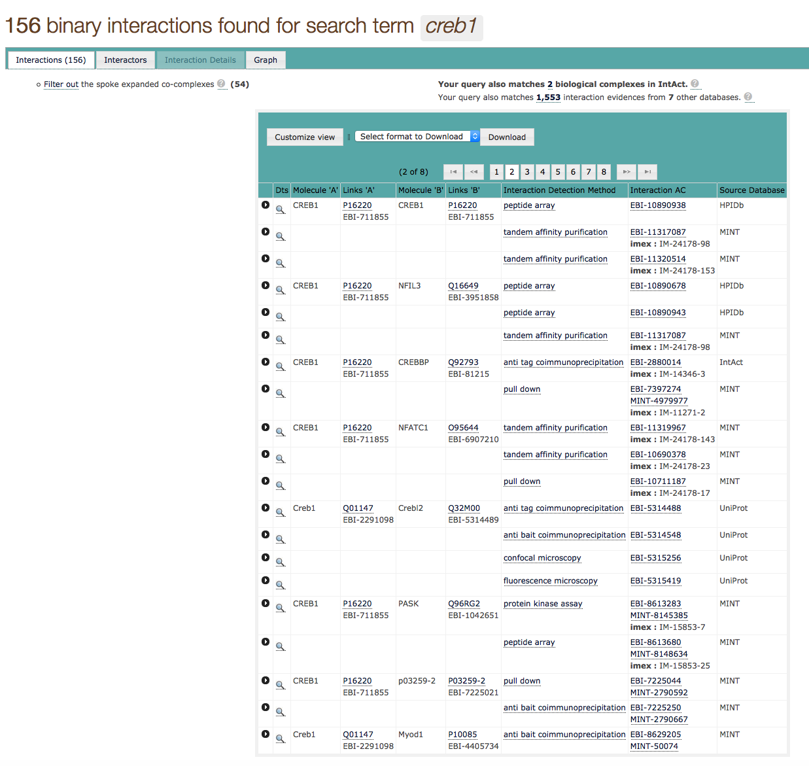
The IntAct database: the result page

Slide 22
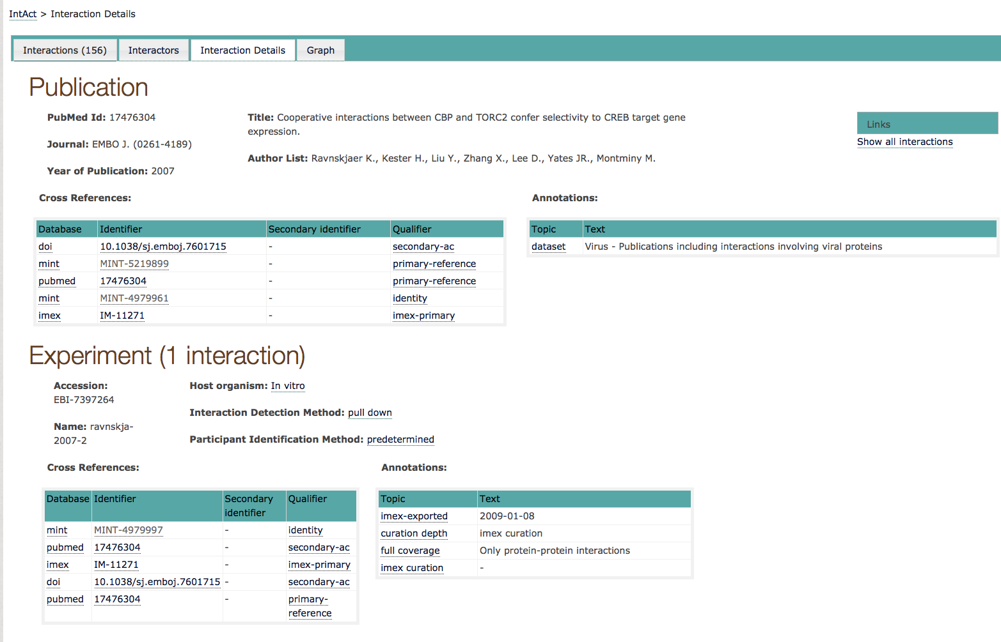
The IntAct database: interaction details

Slide 23
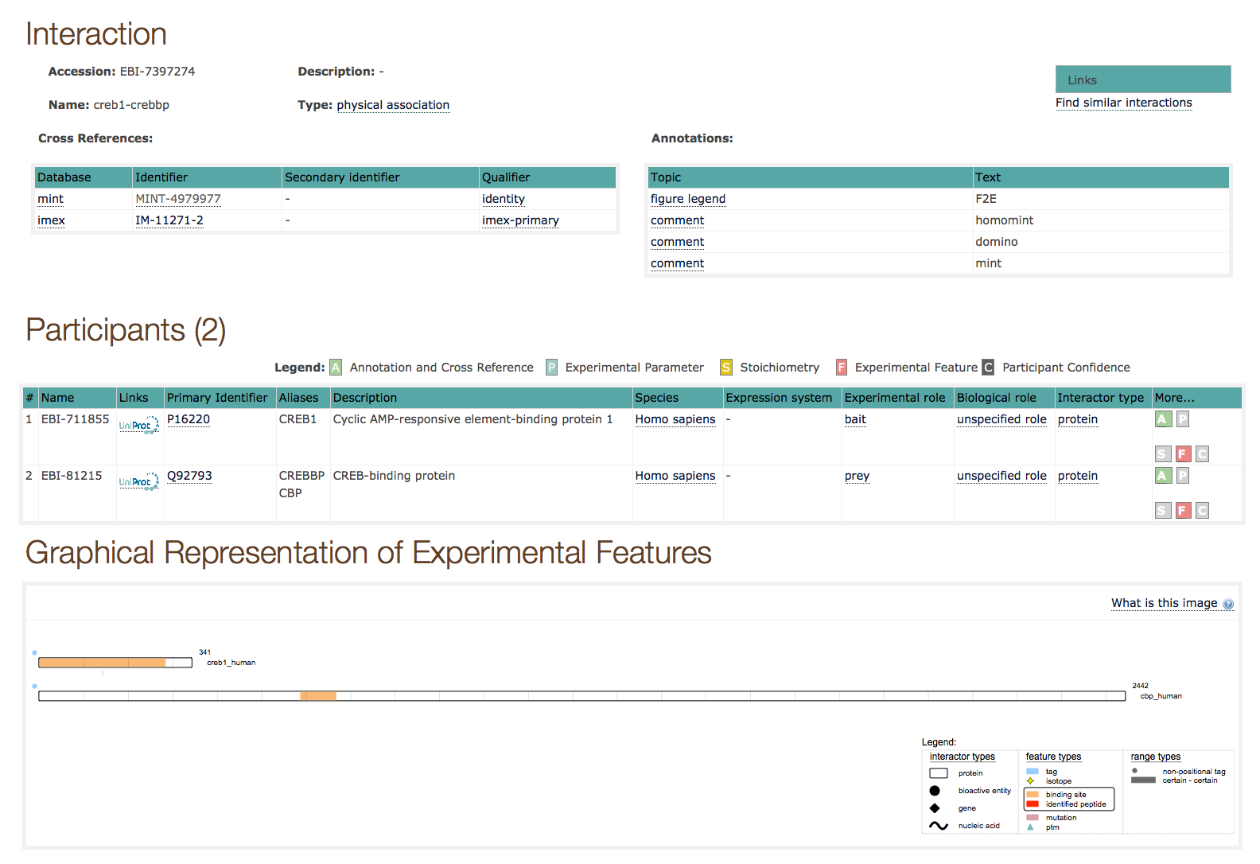
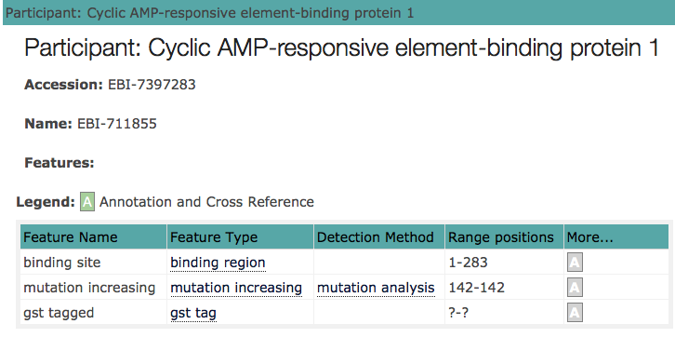
The IntAct database: interaction details

Slide 24
The IntAct database: network visualisation
Network visualisation of the interactions present in a specific paper

Slide 25
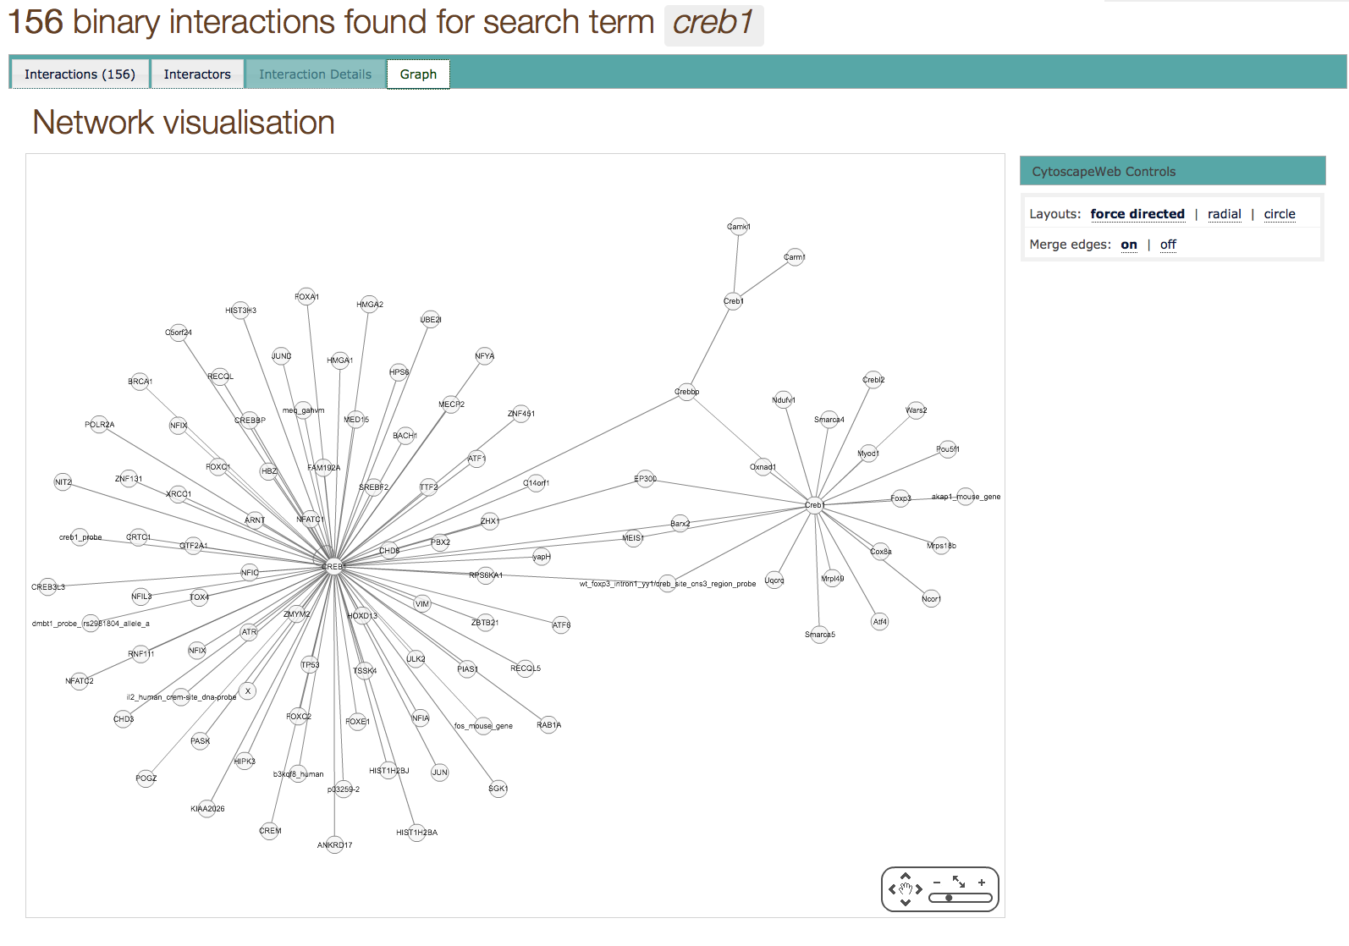
The IntAct database
Network visualisation of all the “Creb1” interactions present in the database

Slide 27
Practical 1: Protein-Protein Interactions and Bioinformatics tools
Training session: Searching IntAct database
In this training session you will use the IntAct database.
perform different search
check the number of interaction evidences
look for the experimental details
download data using different formats.
Step1: Quick Search
Step2: Refining a search using the Advanced Search
Step3: Download data

Slide 28
References
Kerrien S, Aranda B, Breuza L, Bridge A, Broackes-Carter F, Chen C, Duesbury M, Dumousseau M, Feuermann M, Hinz U, Jandrasits C, Jimenez RC, Khadake J, Mahadevan U, Masson P, Pedruzzi I, Pfeiffenberger E, Porras P, Raghunath A, Roechert B, Orchard S, Hermjakob H (2012) The IntAct molecular interaction database in 2012. Nucleic Acids Res 40:D841–6. doi: 10.1093/nar/gkr1088
Licata L, Briganti L, Peluso D, Perfetto L, Iannuccelli M, Galeota E, Sacco F, Palma A, Nardozza AP, Santonico E, Castagnoli L, Cesareni G (2012) MINT, the molecular interaction database: 2012 update. Nucleic Acids Res 40:D857–61. doi: 10.1093/nar/gkr930
Orchard S, Ammari M, Aranda B, Breuza L, Briganti L, Broackes-Carter F, Campbell NH, Chavali G, Chen C, del-Toro N, Duesbury M, Dumousseau M, Galeota E, Hinz U, Iannuccelli M, Jagannathan S, Jimenez R, Khadake J, Lagreid A, Licata L, Lovering RC, Meldal B, Melidoni AN, Milagros M, Peluso D, Perfetto L, Porras P, Raghunath A, Ricard-Blum S, Roechert B, Stutz A, Tognolli M, van Roey K, Cesareni G, Hermjakob H (2014) The MIntAct project--IntAct as a common curation platform for 11 molecular interaction databases. Nucleic Acids Res 42:D358–63. doi: 10.1093/nar/gkt1115
Orchard S, Salwinski L, Kerrien S, Montecchi-Palazzi L, Oesterheld M, Stümpflen V, Ceol A, Chatr-aryamontri A, Armstrong J, Woollard P, Salama JJ, Moore S, Wojcik J, Bader GD, Vidal M, Cusick ME, Gerstein M, Gavin A-C, Superti-Furga G, Greenblatt J, Bader J, Uetz P, Tyers M, Legrain P, Fields S, Mulder N, Gilson M, Niepmann M, Burgoon L, De Las Rivas J, Prieto C, Perreau VM, Hogue C, Mewes H-W, Apweiler R, Xenarios I, Eisenberg D, Cesareni G, Hermjakob H (2007) The minimum information required for reporting a molecular interaction experiment (MIMIx). Nat Biotechnol 25:894–8. doi: 10.1038/nbt1324
Koh GC, Porras P, Aranda B, Hermjakob H, Orchard SE., Analyzing protein-protein interaction networks. J Proteome Res. 2012 Apr 6;11(4):2014-31. doi: 10.1021/pr201211w. Epub 2012 Mar 2. Review.
Orchard S., Molecular interaction databases. Proteomics. 2012 May;12(10):1656-62. doi: 10.1002/pmic.201100484. Review.

Slide 29
Sable&Jois, Molecules, 2015

Slide 30
Web resources describing results of PPI experiments

Slide 31
Web resources describing PPI data
Several Web resources describing PPI data exist
UNIPROT
PDB
PSICQUIC
MENTHA and VIRUS MENTHA

Slide 32
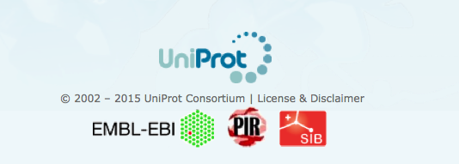
UniProt
Uniprot is the highest quality and most accurately annotated protein sequence database.
A non redundant protein database, with maximal coverage including splicing isoforms, disease variants and PTMs.
Easy protein identification, stable identifiers and consistent nomenclature/controlled vocabularies.
Detailed information on protein function, biological processes, molecular interactions and pathways cross-referenced to external source

Slide 33
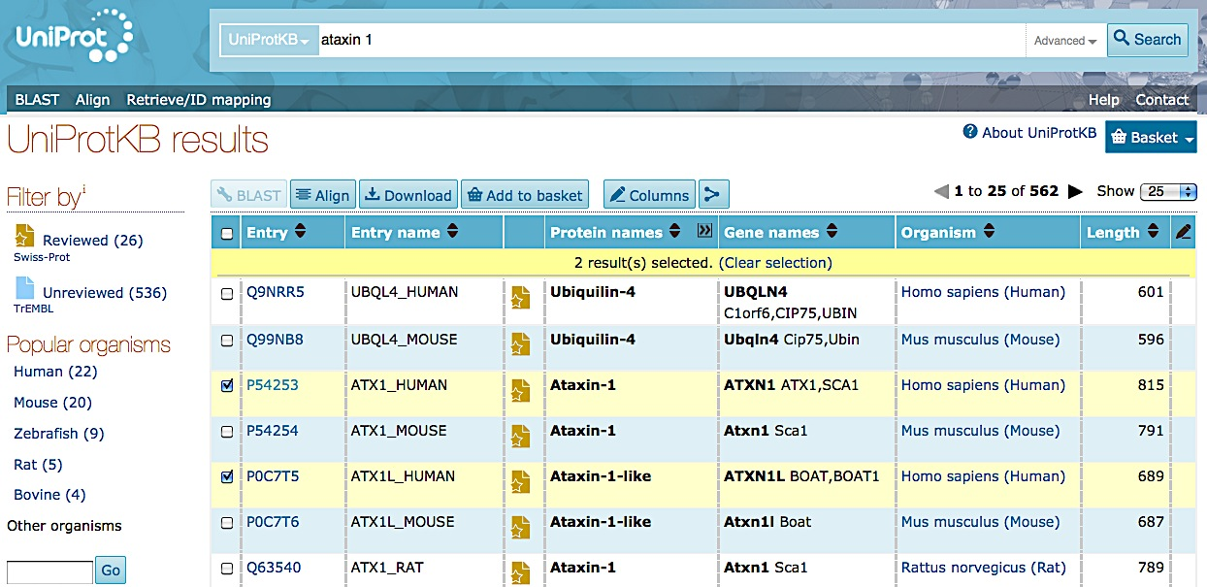
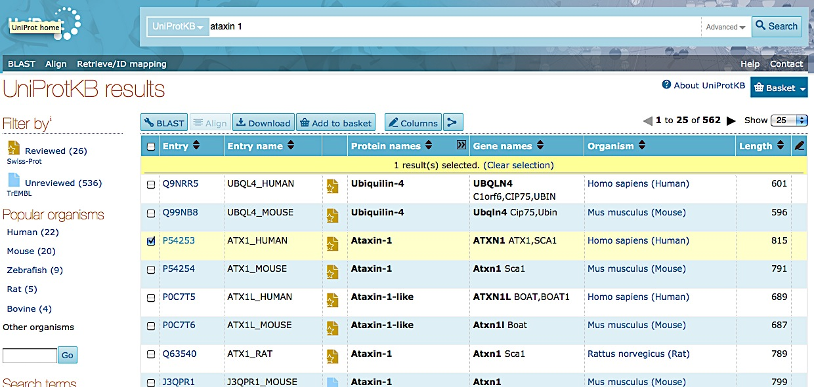
UniProt Search

Slide 34
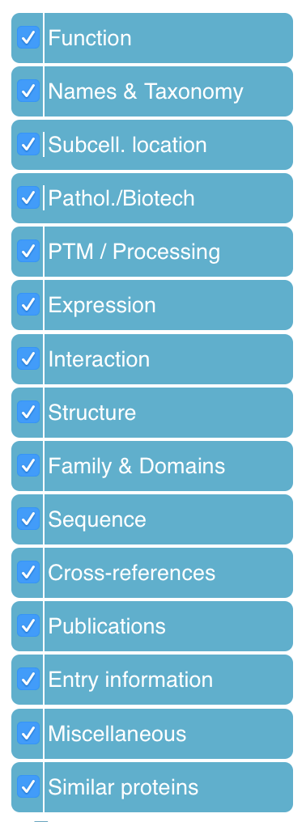
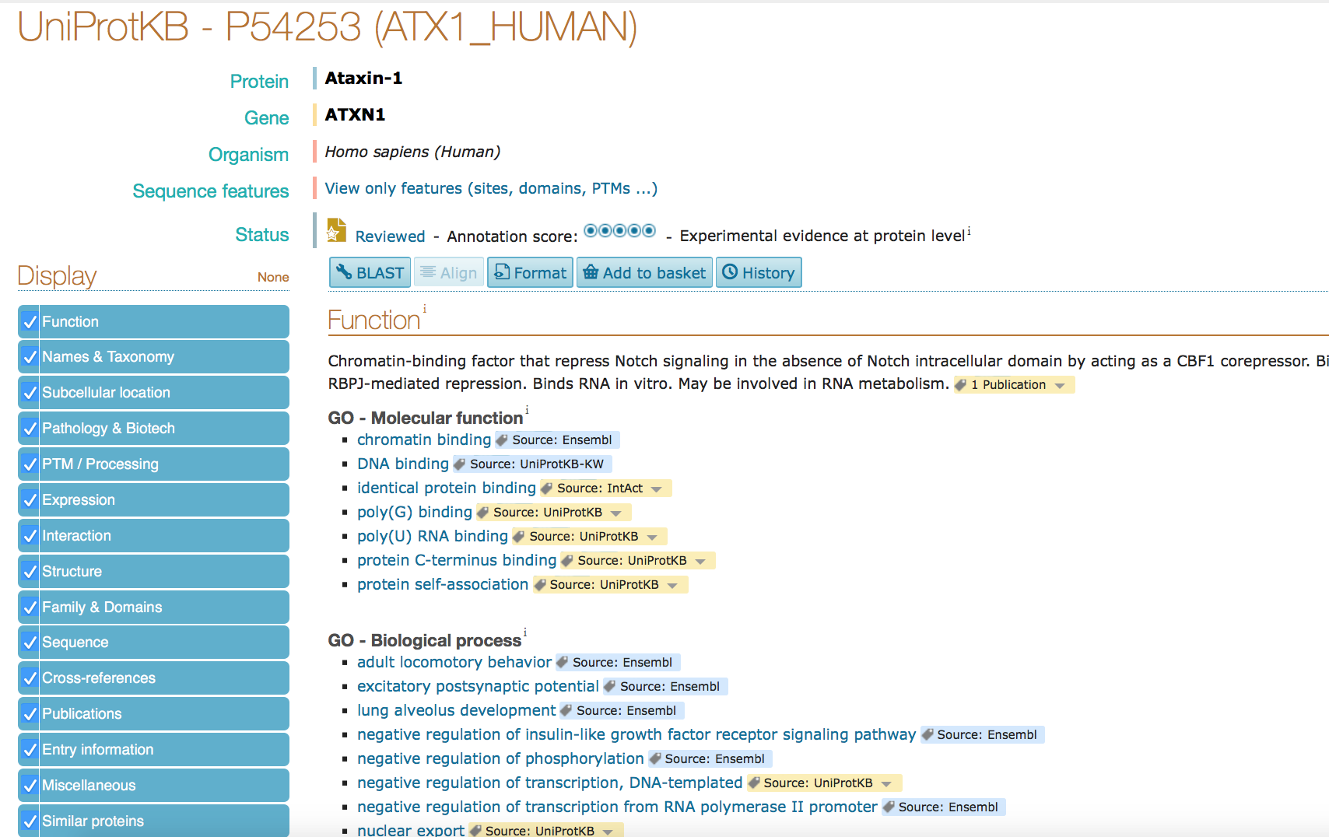
PROTEIN INFORMATION

Slide 35
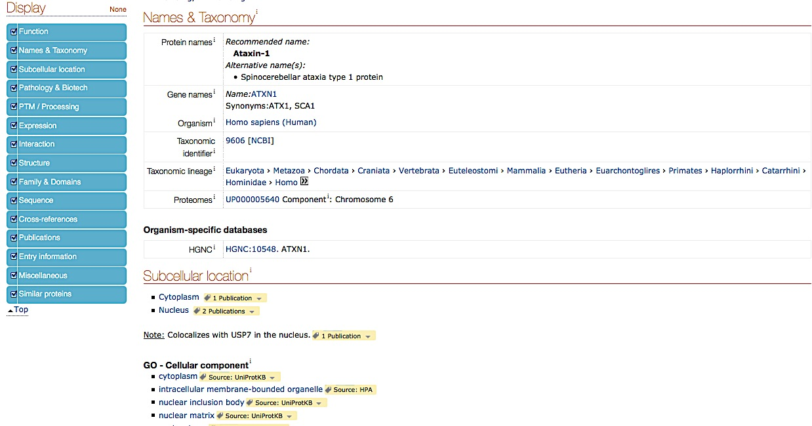
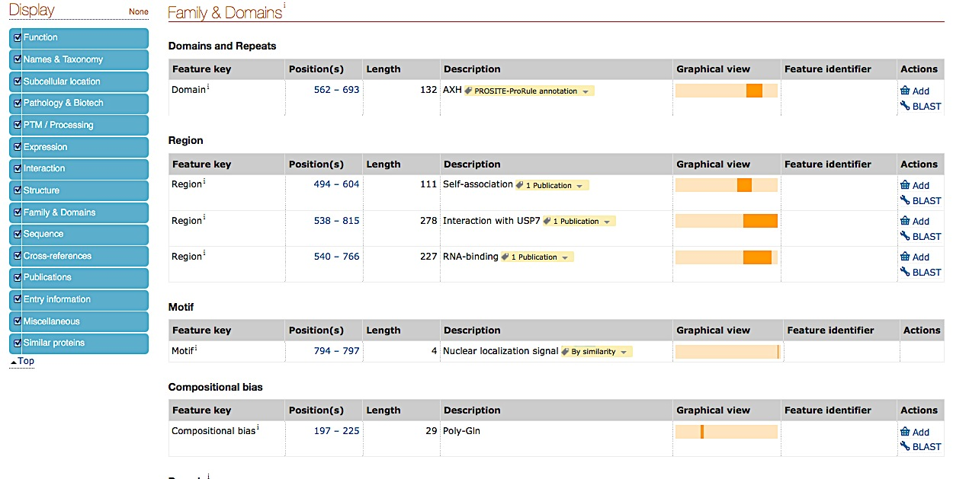
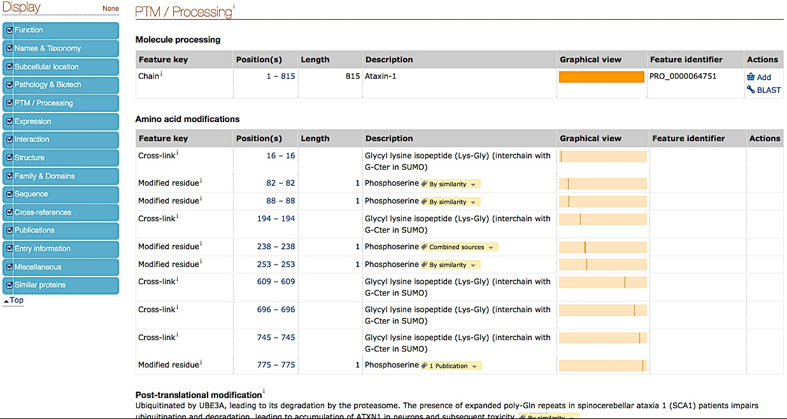
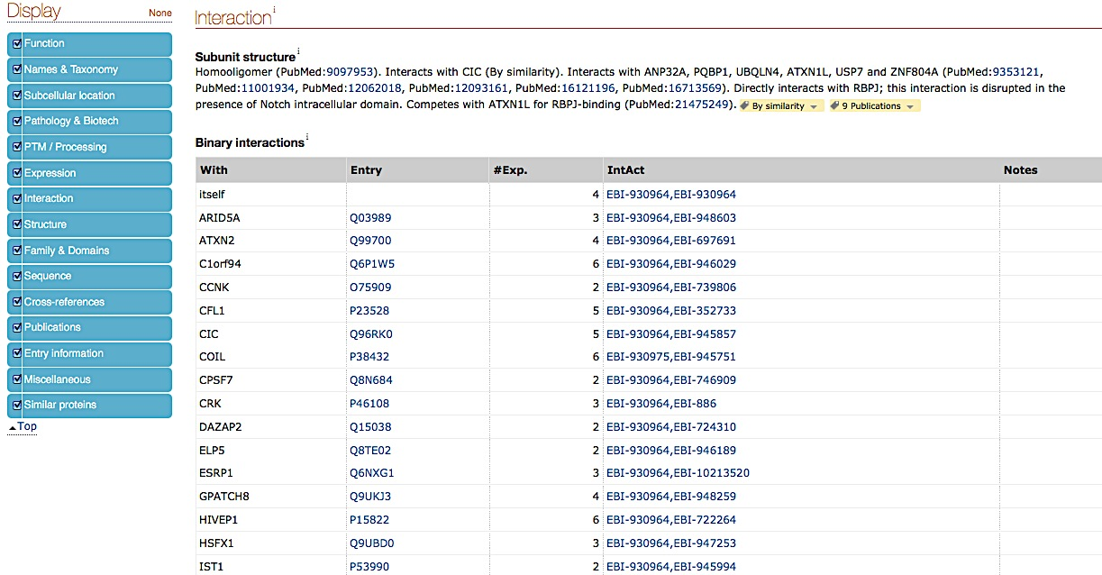
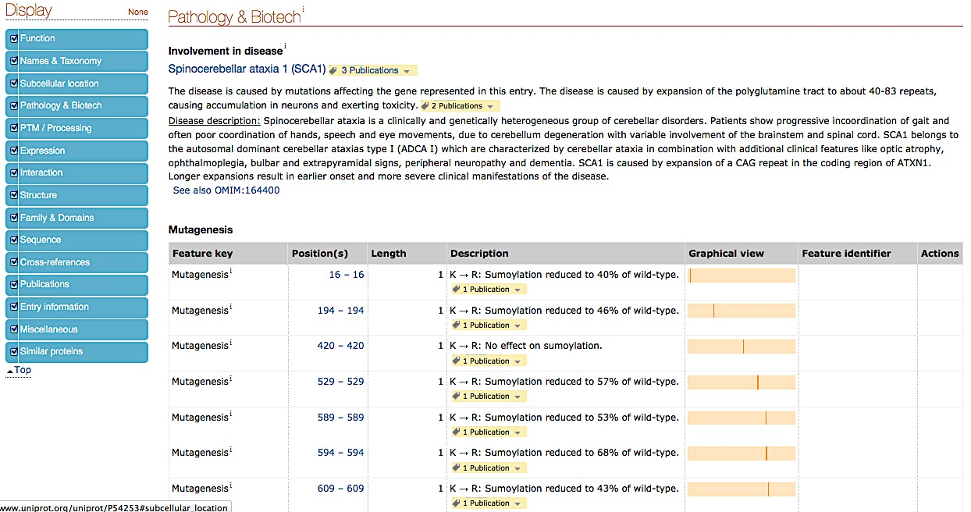
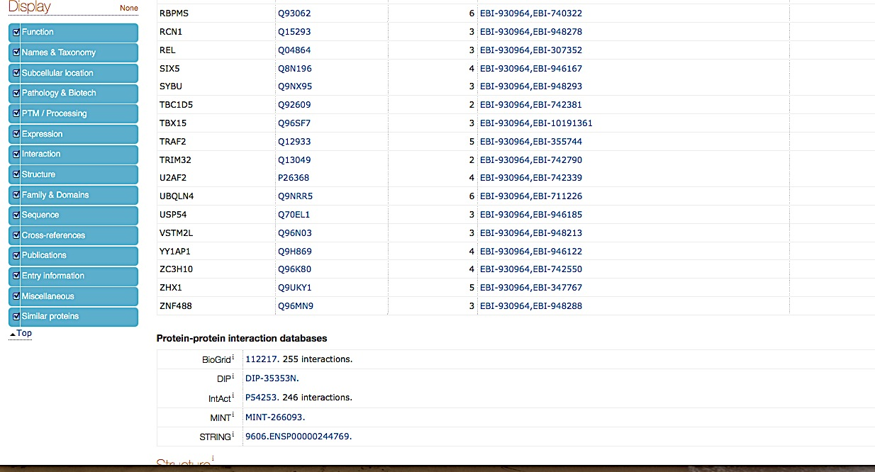
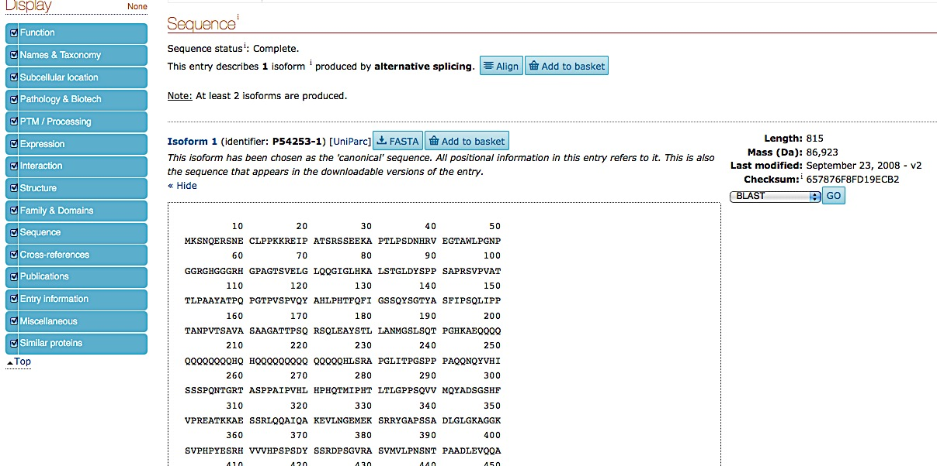
GOING IN DETAILS…

Slide 36
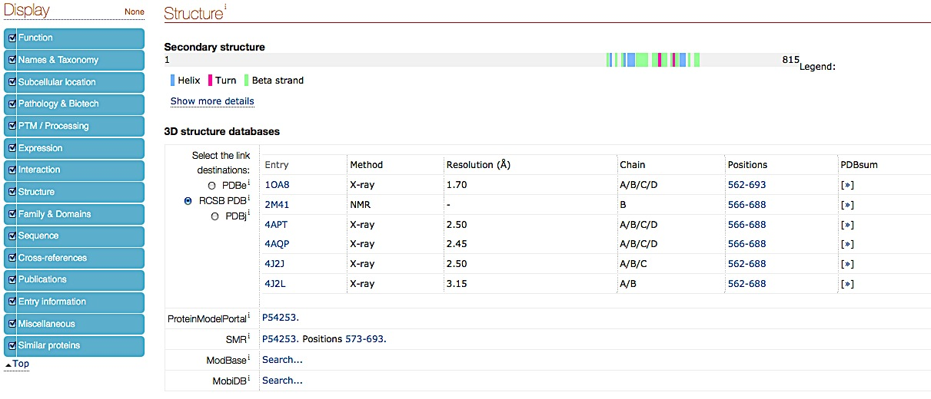
STRUCTURAL INFORMATION IN UNIPROT

Slide 37
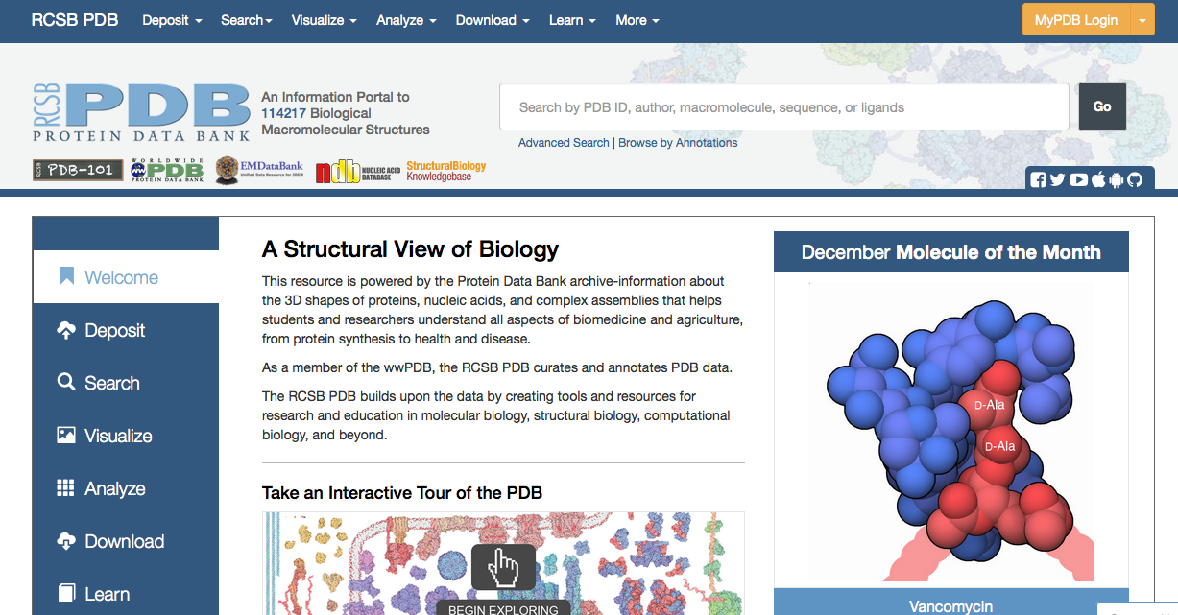
PROTEIN DATA BANK (PDB)
PDB is an portal promoting exploration in the world of proteins and nucleic acids.
Along with our Worldwide PDB collaborators, RCSB PDB curates, annotates, and makes publicly available the PDB data deposited by scientists around the globe.
The RCSB PDB provides a window to these data through a rich online resource with powerful searching, reporting, and visualization tools for researchers.

Slide 38
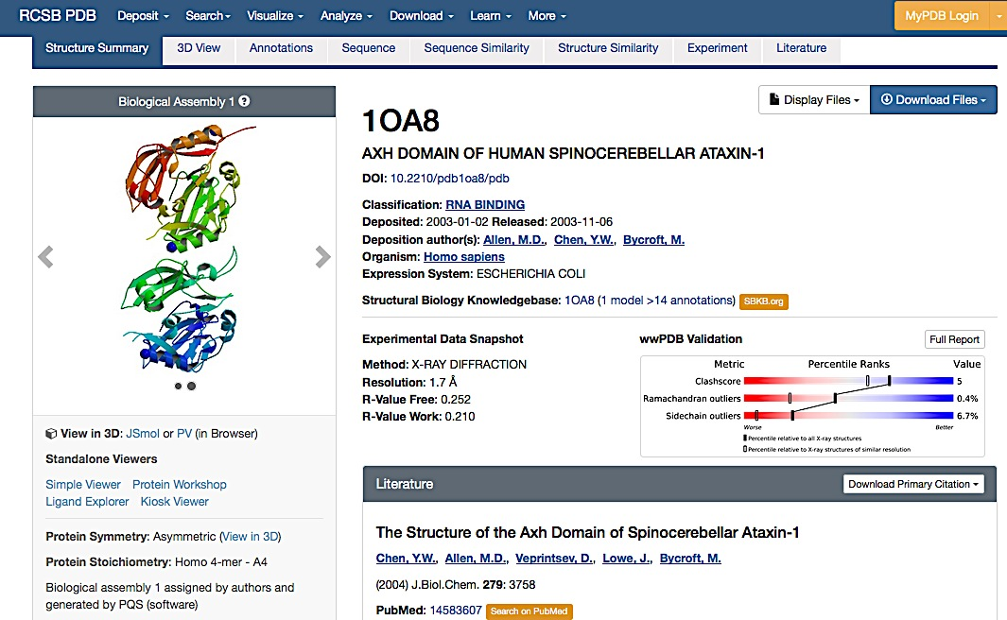
PDB:1OA8

Slide 39

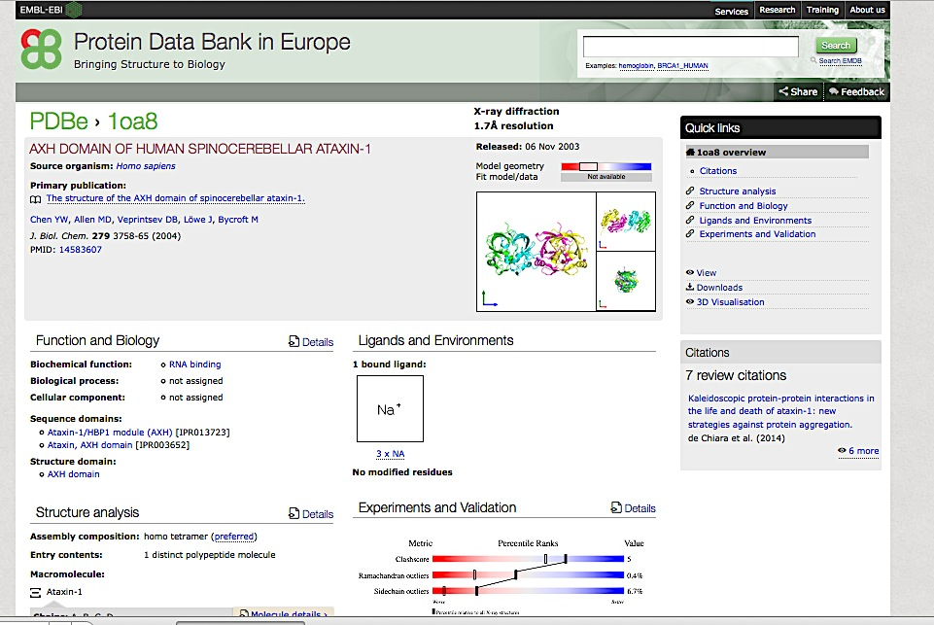
PDBe

Slide 40
Map proteins into UniProt reference sequence database
UniProtKB is the protein sequence reference database chosen by the majority of the interaction databases.
Choosing UniProtKB allow the curators to annotate:
the specific isoform utilized in an experiment
to describe all isoforms simultaneously (using the canonical sequence)
To specify a peptide, resulting from a post-translational cleavage.
Uniprot mapping tool allow users to convert several proteins identifiers to UniProt ACs

Slide 41
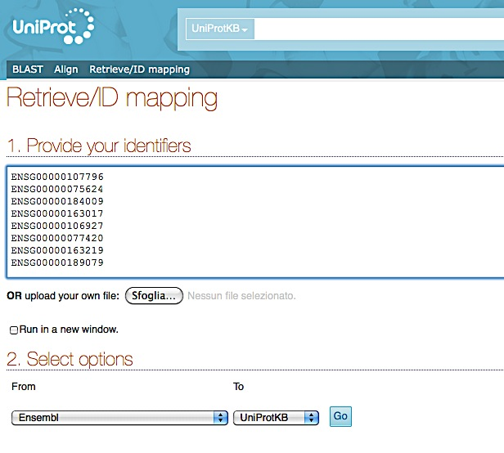
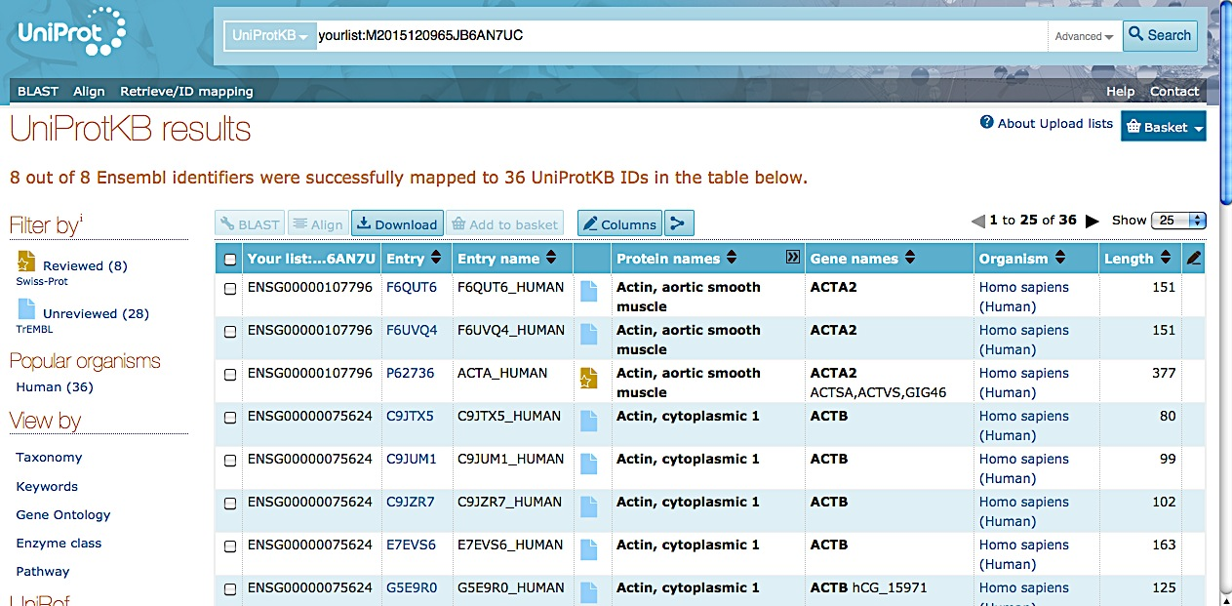
Uniprot Retrieve/ID mapping

Slide 42
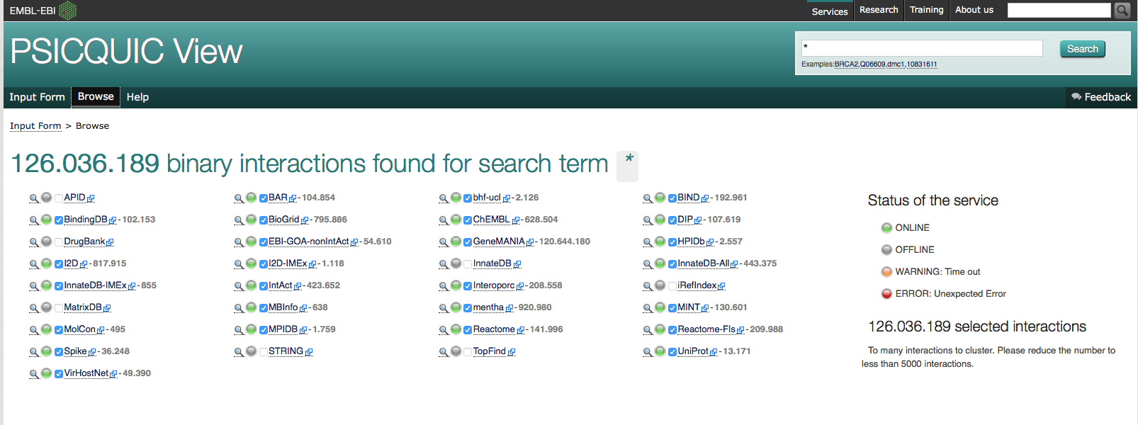
PSICQUIC (PSI Common Query Interface)
PSICQUIC is an effort from the HUPO Proteomics Standard Initiative (HUPO-PSI) to standardize the access to molecular interaction databases programmatically.
It is available at:
http://www.ebi.ac.uk/Tools/webservices/psicquic/view/main.xhtml
and users can obtain results both in MITAB 2.5, 2.6 and 2.7 or PSI-XML formats using the MIQL 2.7 query language

Slide 43
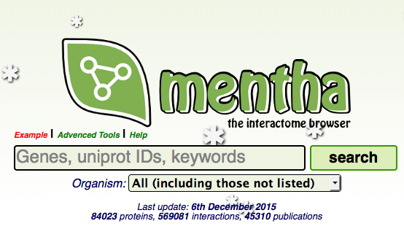
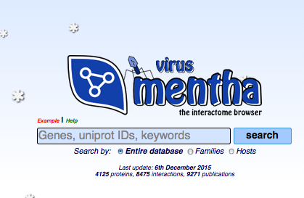
MENTHA and VIRUS MENTHA
An interactome browser that offers protein-protein physical/enzymatic interaction information integrated from various sources. Its data comes from manually curated protein-protein interaction databases
virus mentha archives evidence about viral protein-protein interactions Viruses vs Hosts and viceversa - evidence collected from different databases that have adhered to the IMEx consortium.

Slide 44
Practical 2: Web resources describing results of PPI experiments
Training session: Searching UniProt,
In this training session you will use UniProt database.
perform different search
check the cross-references
look for the PDB information
look for the PPIs information
Step2: UniProt and PDB
Step3: UniProt and PPI
Step4: Protein isoforms

Slide 45
Course on Protein Networks and Systems Biology
References
Taylor CF, Hermjakob H, Julian RK, Garavelli JS, Aebersold R, Apweiler R (2006) The work of the Human Proteome Organisation’s Proteomics Standards Initiative (HUPO PSI). OMICS 10:145–51. doi: 10.1089/omi.2006.10.145
Hermjakob H, Montecchi-Palazzi L, Bader G, Wojcik J, Salwinski L, Ceol A, Moore S, Orchard S, Sarkans U, von Mering C, Roechert B, Poux S, Jung E, Mersch H, Kersey P, Lappe M, Li Y, Zeng R, Rana D, Nikolski M, Husi H, Brun C, Shanker K, Grant SGN, Sander C, Bork P, Zhu W, Pandey A, Brazma A, Jacq B, Vidal M, Sherman D, Legrain P, Cesareni G, Xenarios I, Eisenberg D, Steipe B, Hogue C, Apweiler R (2004) The HUPO PSI’s molecular interaction format--a community standard for the representation of protein interaction data. Nat Biotechnol 22:177–83. doi: 10.1038/nbt926
Orchard S, Kerrien S, Abbani S, Aranda B, Bhate J, Bidwell S, Bridge A, Briganti L, Brinkman FSL, Brinkman F, Cesareni G, Chatr-aryamontri A, Chautard E, Chen C, Dumousseau M, Goll J, Hancock REW, Hancock R, Hannick LI, Jurisica I, Khadake J, Lynn DJ, Mahadevan U, Perfetto L, Raghunath A, Ricard-Blum S, Roechert B, Salwinski L, Stümpflen V, Tyers M, Uetz P, Xenarios I, Hermjakob H (2012) Protein interaction data curation: the International Molecular Exchange (IMEx) consortium. Nat Methods 9:345–50. doi: 10.1038/nmeth.1931
The Universal Protein Resource (UniProt) 2009. Nucleic Acids Res 37:D169–74. doi: 10.1093/nar/gkn664
Kerrien S, Orchard S, Montecchi-Palazzi L, Aranda B, Quinn AF, Vinod N, Bader GD, Xenarios I, Wojcik J, Sherman D, Tyers
M, Salama JJ, Moore S, Ceol A, Chatr-Aryamontri A, Oesterheld M, Stümpflen V, Salwinski L, Nerothin J, Cerami E, Cusick
ME, Vidal M, Gilson M, Armstrong J, Woollard P, Hogue C, Eisenberg D, Cesareni G, Apweiler R, Hermjakob H (2007) Broadening the horizon-- level 2.5 of the HUPO-PSI format for molecular interactions. BMC Biol 5:44. doi: 10.1186/1741-7007-5-44
Aranda B, Blankenburg H, Kerrien S, Brinkman FSL, Ceol A, Chautard E, Dana JM, De Las Rivas J, Dumousseau M, Galeota E, Gaulton A, Goll J, Hancock REW, Isserlin R, Jimenez RC, Kerssemakers J, Khadake J, Lynn DJ, Michaut M, O’Kelly G, Ono K, Orchard S, Prieto C, Razick S, Rigina O, Salwinski L, Simonovic M, Velankar S, Winter A, Wu G, Bader GD, Cesareni G, Donaldson IM, Eisenberg D, Kleywegt GJ, Overington J, Ricard-Blum S, Tyers M, Albrecht M, Hermjakob H (2011) PSICQUIC and PSISCORE: accessing and scoring molecular interactions. Nat Methods 8:528–9. doi: 10.1038/nmeth.1637
del-Toro N, Dumousseau M, Orchard S, Jimenez RC, Galeota E, Launay G, Goll J, Breuer K, Ono K, Salwinski L, Hermjakob
H (2013) A new reference implementation of the PSICQUIC web service. Nucleic Acids Res 41:W601–6. doi:
10.1093/nar/gkt392
Calderone A, Castagnoli L, Cesareni G (2013) mentha: a resource for browsing integrated protein-interaction networks. Nat Methods 10:690–1. doi: 10.1038/nmeth.2561
Calderone A, Licata L, Cesareni G (2015) VirusMentha: a new resource for virus-host protein interactions. Nucleic Acids Res 43:D588–92. doi: 10.1093/nar/gku830
Mayer G, Jones AR, Binz PA, Deutsch EW, Orchard S, Montecchi-Palazzi L, Vizcaíno JA, Hermjakob H, Oveillero D, Julian R, Stephan C, Meyer HE, Eisenacher M., Controlled vocabularies and ontologies in proteomics: overview, principles and practice. Biochim Biophys Acta. 2014 Jan;1844(1 Pt A):98-107. doi: 10.1016/j.bbapap.2013.02.017. Epub 2013 Feb 19. Review.
Orchard S., Data standardization and sharing-the work of the HUPO-PSI. Biochim Biophys Acta. 2014 Jan;1844(1 Pt A):82-7. doi: 10.1016/j.bbapap.2013.03.011. Epub 2013 Mar 20. Review.

